Slide 1
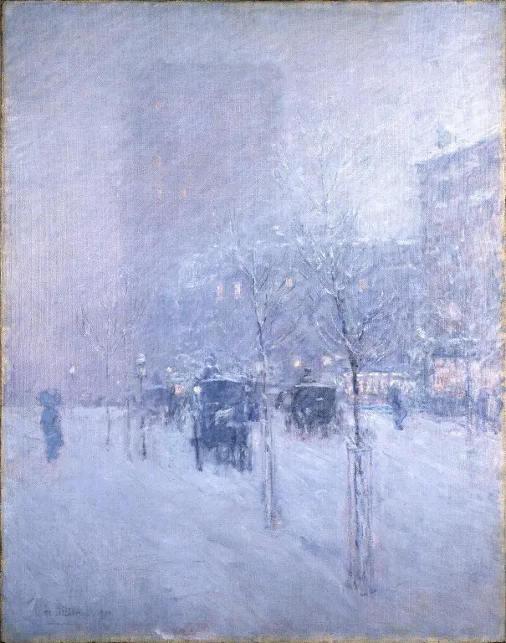
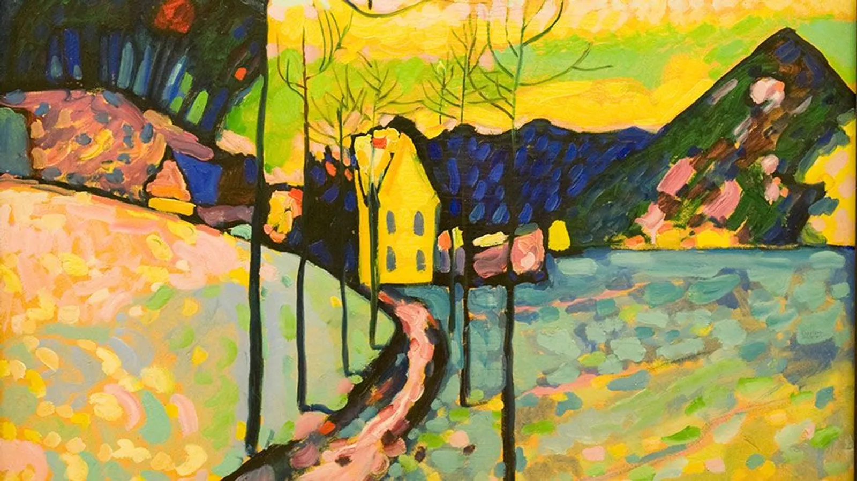
Winter Landscape – Wassily Kandinsky
Late Afternoon, New York, Winter, 1900 – Frederick Childe Hassam

Slide 2
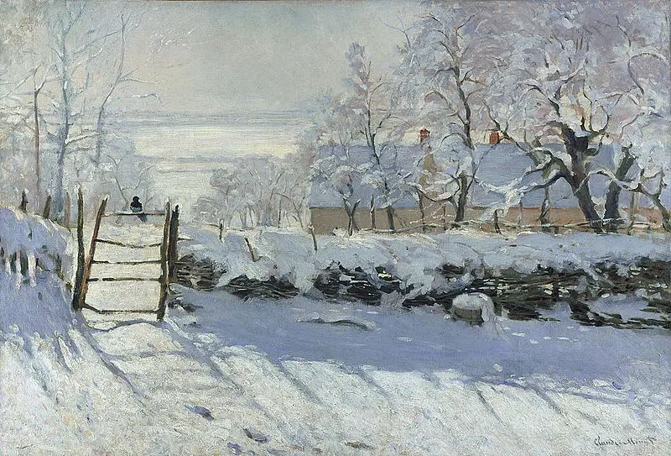
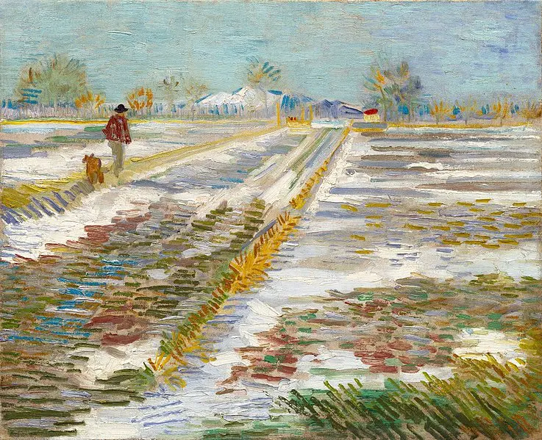
The Magpie - Claude Monet
Landscape under snow – Vincent Van Gogh

Slide 3
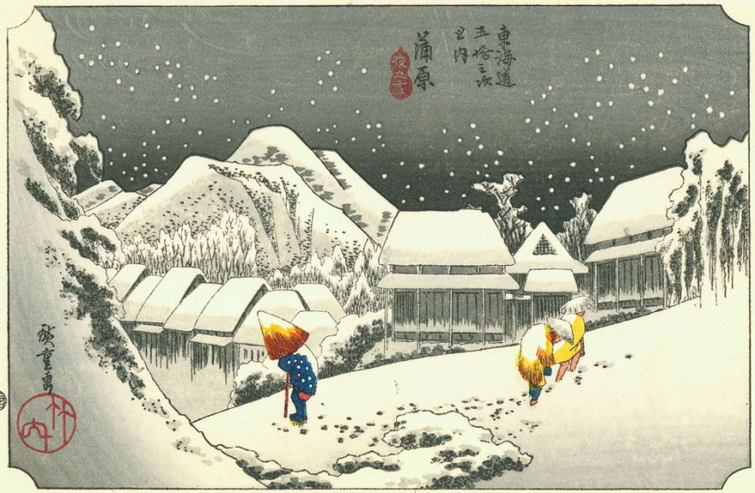
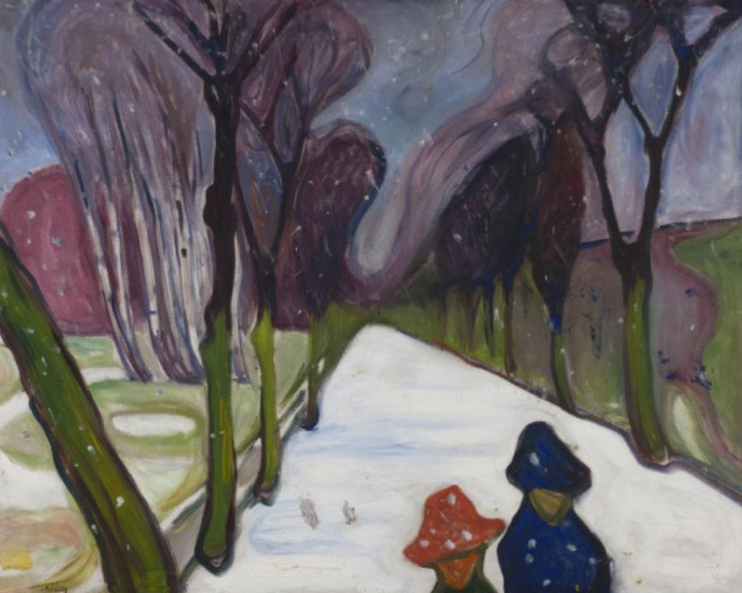
Night Snow at Kambara – Utagawa Hiroshiga
New Snow in the Avenue – Edvard Munch

Slide 4
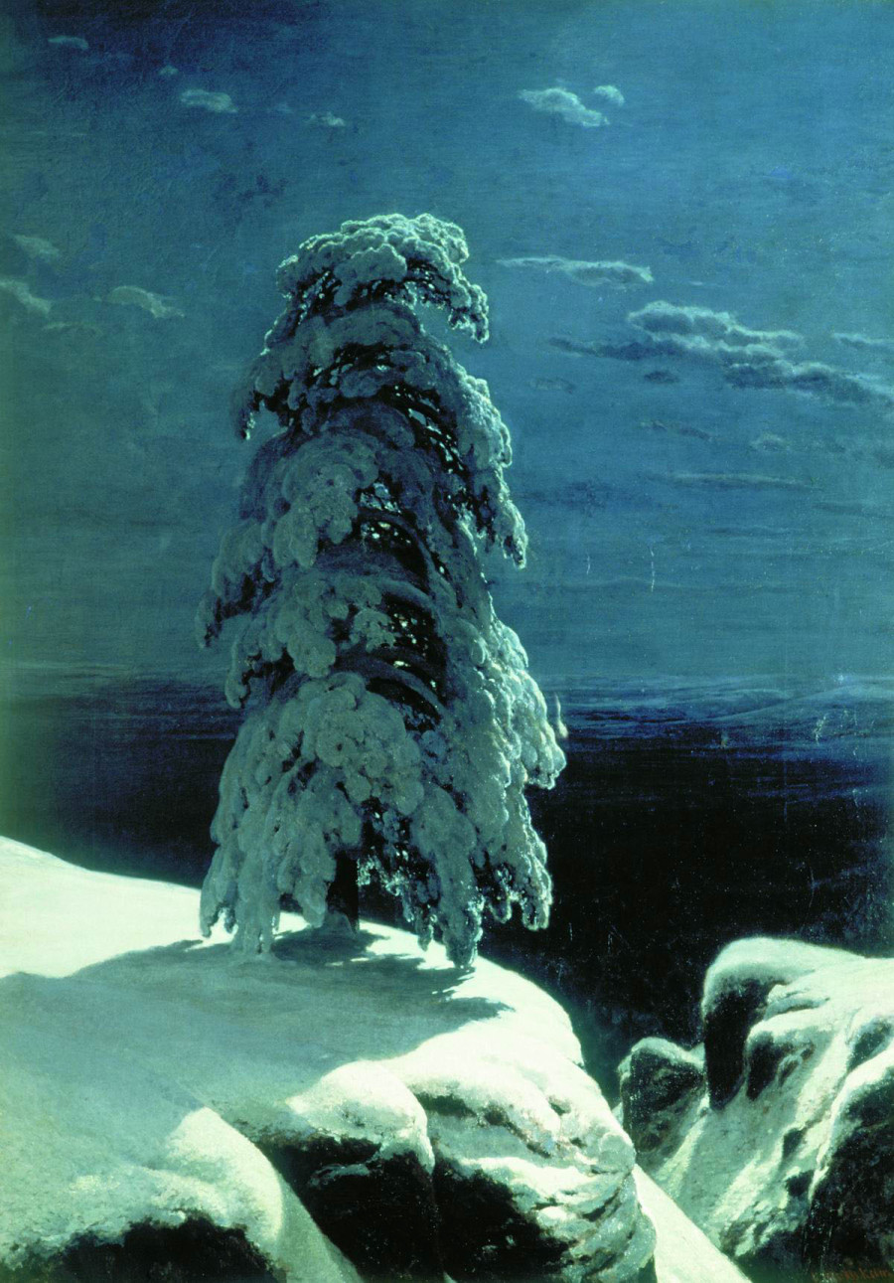
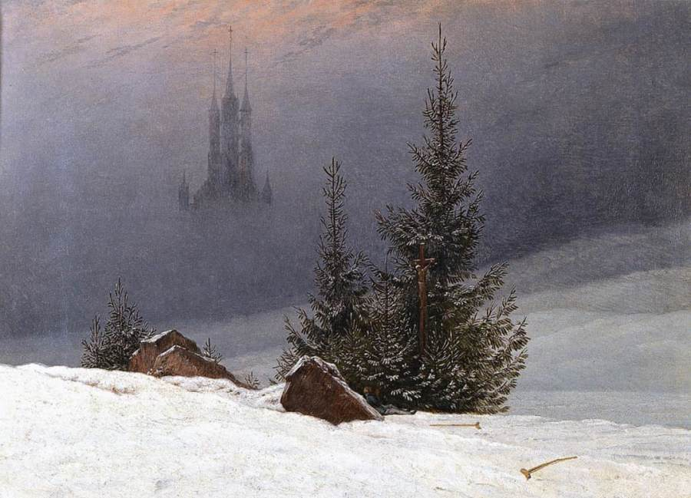
Winter Landscape with Church - Caspar David Friedrich
In the Wild North - Ivan Shishkin

