Slide 1

Phonics Screening
Year 2
A guide for parents.

Slide 2
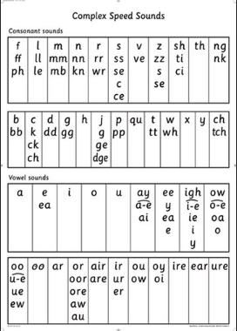
What is Phonics?
Children are taught to read by breaking down (segmenting) words into separate sounds or ‘phonemes’. At St Mary’s we call this ‘Fred Talk’. Children are then taught how to blend these sounds together to read the whole word.
Children in Year 2 have an hour phonics lesson daily and they are encouraged to use strategies taught in these lessons to read and write in other lessons as well.

Slide 3
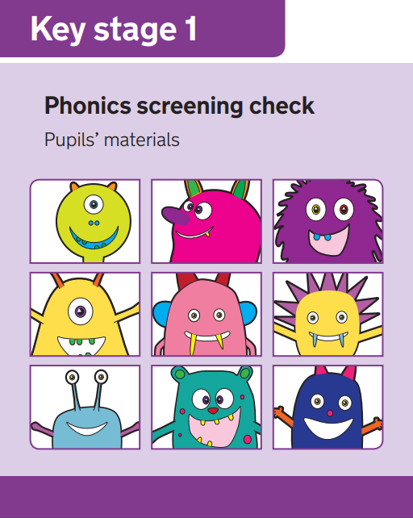
What is the aim of the check?
The Phonics Screening Check is designed to confirm whether children have learnt phonic decoding and blending skills to an appropriate standard.
This check will allow teachers to ensure that any gaps in children’s knowledge is filled by the end of Year 2.

Slide 4
When will the screening happen?
Every Year 2 child in the country will be taking the Phonics Screening Check in December to make up for the missed check in June.
Those Year 2 children who don’t pass will be taking the check again later in the school year.
The results will be reported to parents.

Slide 5
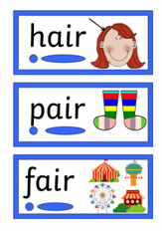
What do we expect children to do?
The check is very similar to tasks the children already complete during phonics lessons.
During the Phonics Screening Check, your child will be asked to read (decode) 40 words. Most of these words are real words but some are pseudo-words (nonsense words). Pseudo-words are included to ensure that your child is using their decoding skills and not just relying on their memory of words they’ve read before.
Children will be asked to ‘sound out’ a word using ‘special friends’ and ‘Fred talk’ and then blend the sounds together, e.g.. l-e-g – leg.

Slide 6
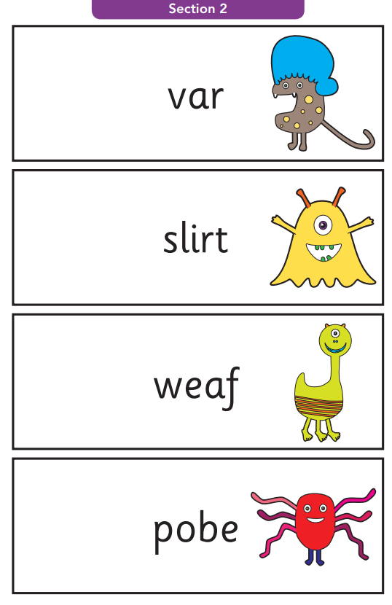
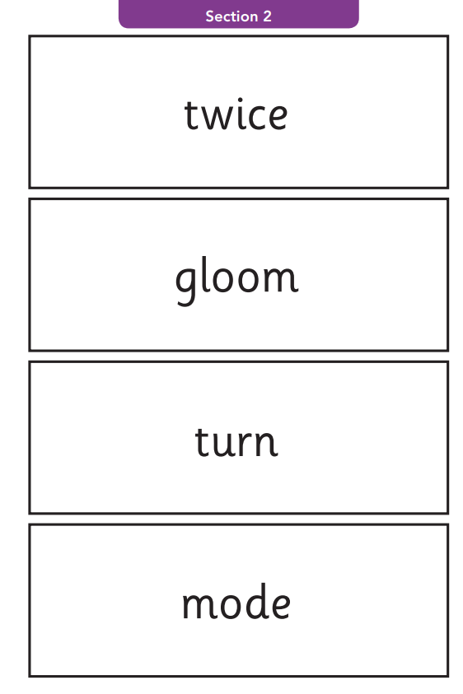
Example words
Alien/Pseudo words
Real words

Slide 7
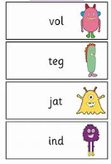
How will the children complete the check?
The children will complete the check one at a time in a quiet area of the school.
This will be completed with a familiar adult to the children. This will be Miss King.
The screening will only take 5-10 mins with each child.

Slide 8
How can you help?
Here is a quick guide to some of the things you can do to help you child in preparation for the Screening Check.
Remind your child to look for the following when faced with an unfamiliar word (real or alien/pseudo).
  Look for any familiar special friends. There are digraphs (Two letters making one sound e.g. ai), trigraphs (Three letters making one sound e.g. igh) and split
  digraphs (two letters making one sound but split from each other e.g. a-e).
  Sounds that are left are single phonemes. Then ‘Fred Talk’ each sound before blending to read the word.
Encourage children to use sound buttons when breaking the words down.
  A dot for a single phoneme, a small line for a digraph/trigraph and a hook for a split digraphs. These should all be placed under the letters in the word. (See next slide for information on sound buttons).
Play some online games.
  See slide 12 for games.

Slide 9
Using sound buttons
Sound buttons help children to recognise different parts of a word.
These will not appear in the test but children should look for special
friends, break down a word into sounds and then blend. This is what they
will be used to from phonics lessons.

Slide 10
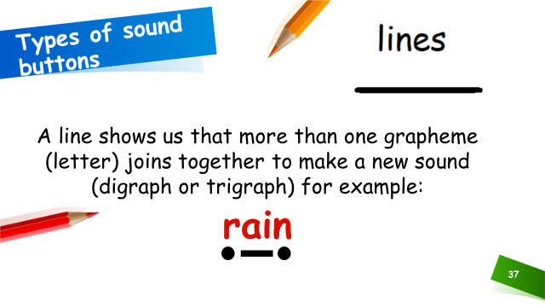
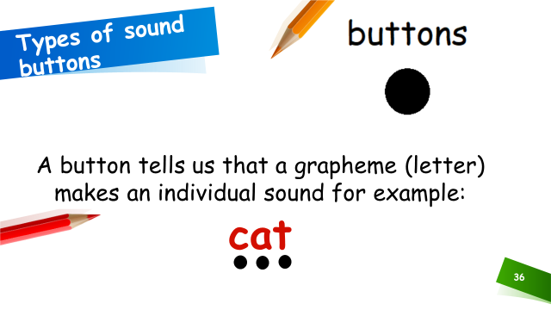
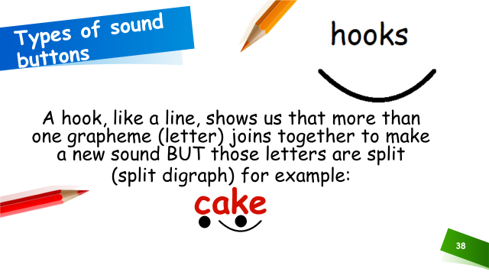
Using sound buttons

Slide 11
Useful websites
Here are some links to helpful websites that give more information on the teaching of Phonics:
  RWI information page for parents (with videos):
  https://www.ruthmiskin.com/en/find-out-more/parents/
  Phoneme pronunciation:
  https://www.youtube.com/watch?v=TkXcabDUg7Q
  Phonics screening information for parents:
  https://www.youtube.com/watch?v=LbKGLJPp6ww
  Past Papers from previous years to look at:
  https://www.gov.uk/government/collections/national-curriculum-assessments-practice-materials#phonics-screening-check-resources

Slide 12
Online Phonics Games
Click on the links below to access free phonics games.
Phonics Bloom
Education.com
Top Marks
Remember, Reading Eggs will also help your child with Phonics!

Slide 13

Questions
If you have any questions regarding the Phonics Screening Check, please contact the school office and ask to speak to your child’s class teacher or Miss King our reading lead.

