Slide 1
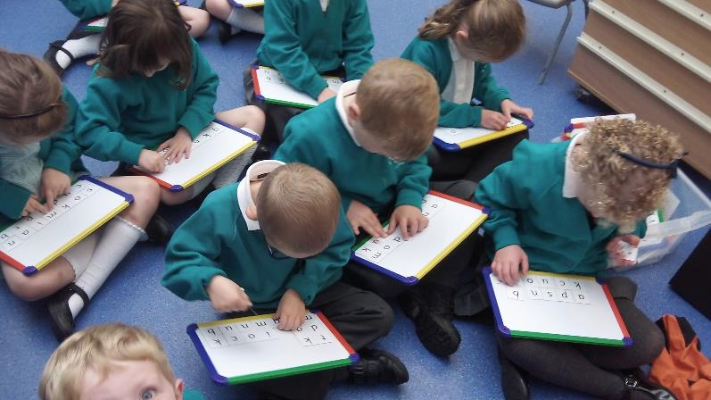

Read, Write Inc.
Literacy and Language
Year 2
The reading teachers in Year 2 are: Mrs Watson, Mrs Honeybourne, Miss King, Mrs Richardson, and Mrs Potts.

Slide 2
Literacy in Year 2- the transition from RWI to Literacy and Language
In Year 2, your child will continue to move through the levels of reading in the RWI phonics programme which began in Reception.
Your child will be assessed every half term to check that they are reading at the right level.
Once your child has been assessed as a fluent reader, they will then move on to the ‘Literacy and Language’ programme. In order to do this, your child will need to read over 100 words per minute from a short text.
Literacy and Language is a complete literacy programme for fluent readers in Years 2 to Year 6 which teaches children to read, write and discuss texts with maturity.
The following slides will give an overview of both the RWI phonics programme and the Literacy and Language programme. We aim for the majority of children to be on the Literacy and Language programme by the end of Year 2.

Slide 3
Why do we use RWI ?
Who is Read Write Inc. Phonics for?
The Read Write Inc. Phonics programme is for primary school children learning to read.
It enables your child to become a confident and fluent reader at their first attempt.
When your child has completed the Read Write Inc. Phonics programme, they will be reading fluently and confidently.
The reading teacher (please refer to the first slide to see a list of reading teachers in Year 2) is guided from the very beginning to help your child become a confident and fluent reader.

Slide 4
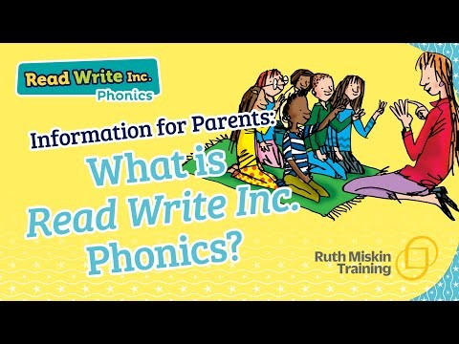
An overview of the RWI programme
*Please note the video states that children bring home the RWI book they are reading in class. At St Mary’s we do not send these books home with the children, (they are only used in class) instead we send home a book from a different reading scheme that is matched by level to the one they are reading in class.

Slide 5
Why we are successful at getting your child to read
The systematic and lively programme is organised by our Reading Leader Miss King.
All of our staff who teach RWI (Teachers and Teaching Assistants) are trained together by the Reading Leader as well as receiving additional training and support from a RWI regional trainer.
Your child will read and write for an hour each day and is grouped according to their reading level.
Your child will not struggle because of work being too difficult nor will they get bored because the work is too easy.
If your child does need extra support to maintain progress, they will work with a reading tutor for 10 minutes in the afternoons to ensure that they do not fall behind their peers.

Slide 6
Spellings and Reading in Year 2
Your child will have learnt one way in which each long vowel sound is written (Set 2 sounds). When learning their Set 3 speed sounds they will be taught that there are more ways in which the same sounds are written, e.g. ee as in tree and ea as in tea.
Set 3 speed sounds reading will be taught for most of Year 1 and Set 3 ‘speed sounds’ spelling during Year 2.
There are 20 Set 3 ‘speed sounds’ that are made up of two or three letters which represent just one sound, e.g. ea as in tea, ow as in cow and are as in care.

Slide 7

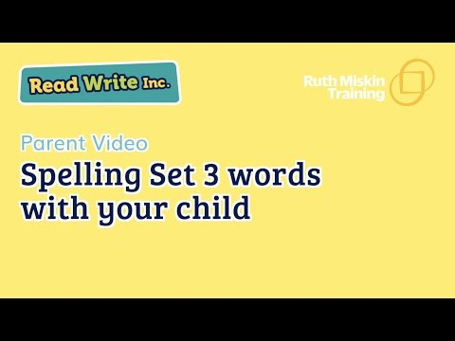
Spelling- How to help your child at home

Slide 8
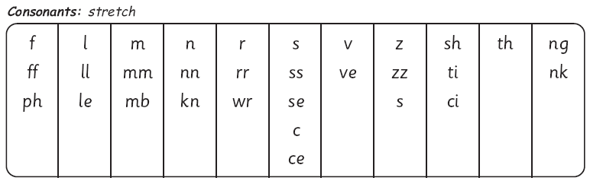
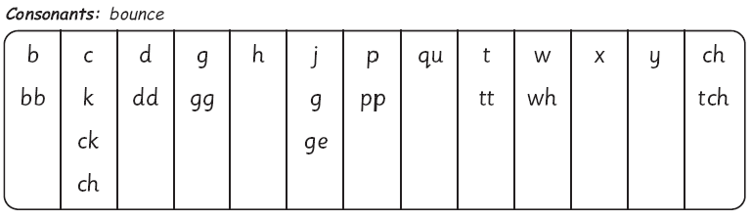
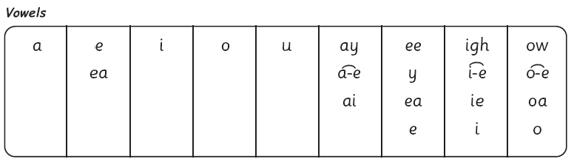
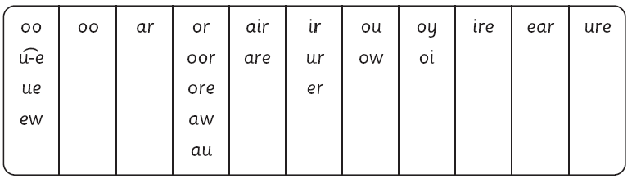
The complex English alphabetic code

Slide 9
What is the Literacy and Language programme?
The Literacy and Language programme follows on from the RWI Phonics programme.
Once your child has completed the RWI phonics programme, they will then move on to the Literacy and Language programme. In order to do this, your child will need to read over 100 words per minute from a short text.
This complete literacy programme for fluent readers in Years 2 to Year 6 teaches children to read, write and discuss texts with maturity.

Slide 10
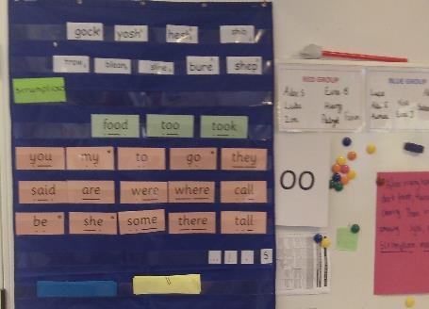
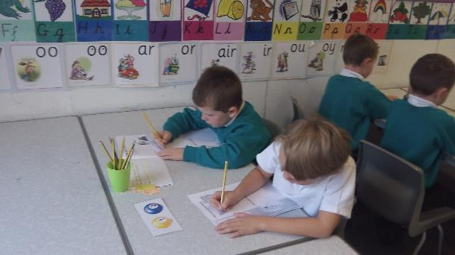
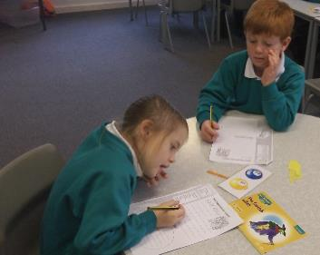
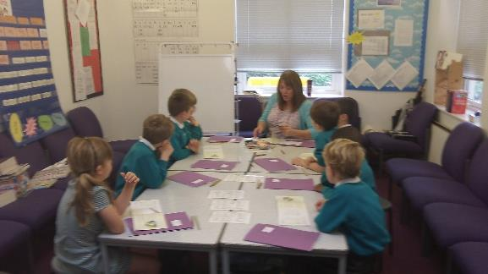
Year 2

Slide 11
How is Literacy and Language organised?
Once your child has been assessed by Miss King to be reading fluently (100+ words per minute) they are then moved on to the Literacy and Language programme.
Your child will be taught for one hour a day by a Teacher.
Your child will be taught in groups of 30 reading at the same level.
Half termly assessments are undertaken by Miss King to check progress.

Slide 12
What does Literacy and Language teach children to do?
A complete literacy programme for fluent readers in year 2.
It develops children’s comprehension, vocabulary, writing, critical thinking and discussion skills.
This is a read to learn programme where as the RWI phonics programme is a learn to read programme.

Slide 13
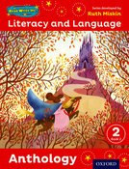
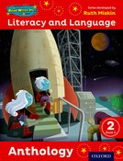


Literacy and Language
Children learn to be a real reader, engaging in the world of books.

Slide 14
Your child will learn how to:
Read complete texts
Develop talk
Ask ‘Big Questions’
Participate in reading activities which feed into writing
Develop vocabulary, grammar and punctuation

Slide 15
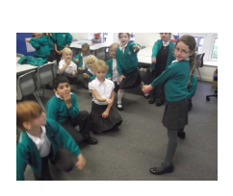
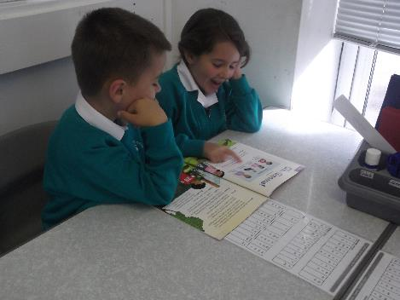
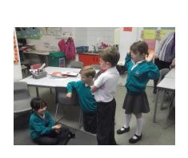
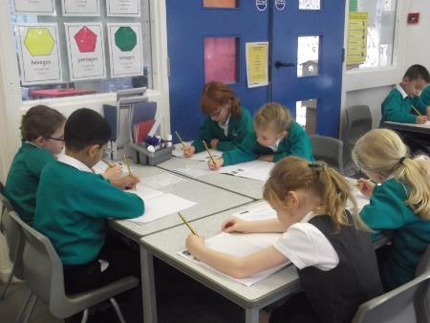
The Principles

Slide 16
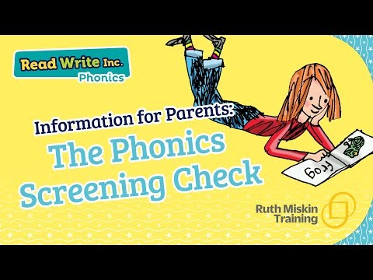
A short video about the Phonics Screening Check- this is for children who did not pass in Year 1.

Slide 17
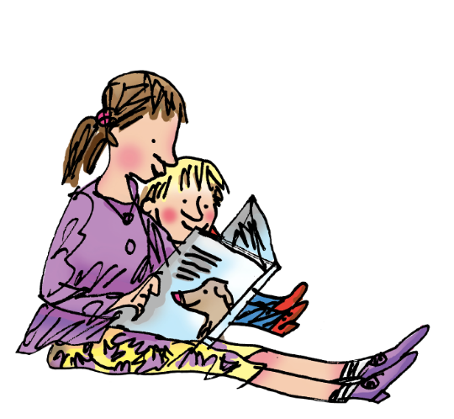

How to help your child at home…

Slide 18
You can read stories with your child. Relentlessly.
"Children are made readers on the laps of their parents." — Emilie Buchwald

Slide 19
You can watch video tutorials and find out more about Read Write Inc by following these links.
Have a look at the parents’ information for tips and resources for supporting your child at home:
How to pronounce the sounds correctly click here:
RWI information page for parents (with videos) click here:
Videos showing how each part of a lesson is taught click here
Advice and support for parents click here
Notes:
Listed above are some useful websites.

Slide 20
Contact us!
If there is anything you are unsure of or if you would like further information, please do not hesitate to contact your childs’ class teacher via the office email or Miss King (Reading Leader) via the office email.
We are more than happy to help!
Office email:
office@st-marysaylesbury.bucksgfl.org.uk
Notes:
Listed above are some useful websites.

