Slide 1

Welcome
Year 1 Read Write Inc. Information Presentation

Slide 2
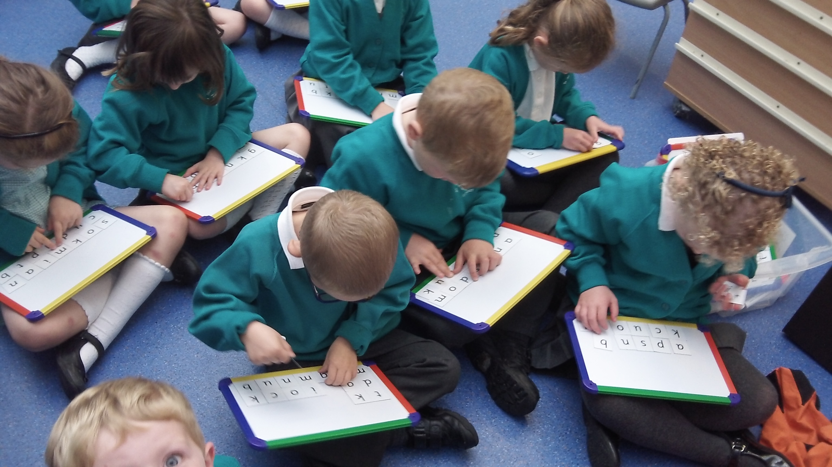
Read, Write Inc. (RWI) in Year 1
The Year 1 team that deliver RWI are: Miss Blackman, Mrs Hoaen, Mrs Baber, Mrs Hutchinson and Mrs Trotter

Slide 3
What is Read Write Inc?
The Read Write Inc. Phonics programme is for primary school children learning to read and write.
It enables your child to become a confident and fluent reader.
Children are taught in ability groups and regularly assessed.

Slide 4
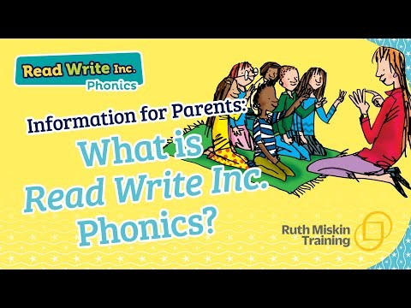
An overview of the RWI programme
*Please note the video states that children bring home the RWI book they are reading in class. At St Mary’s we do not send these books home with the children, (they are only used in class) instead we send home a book from a different reading scheme that is matched by level to the one they are reading in class.

Slide 5
How is the programme used in our school?
The programme is systematic and lively which keeps the children engaged
It is organised by our Reading Leader Miss King.
All of our staff who teach RWI (Teachers and Teaching Assistants) are trained together by the Reading Leader as well as receiving additional training and support from a RWI regional trainer.
Your child will read and write for an hour each day and they are grouped according to their reading level.
If your child needs any extra support to maintain progress, they will work with a member of staff doing short phonic interventions.

Slide 6

How does phonics help us read?
Say “hello” to Fred.
Fred can only talk in sounds...
He says “m_a_t.” Not mat.
We call this Fred Talk.

Slide 7
Spelling

Slide 8
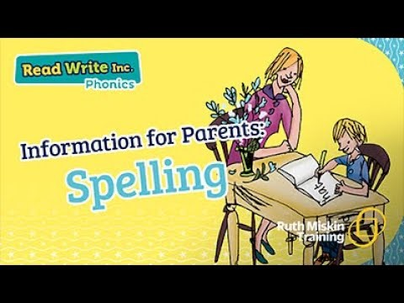
This useful video will help you teach your child how to spell using Fred Fingers

Slide 9
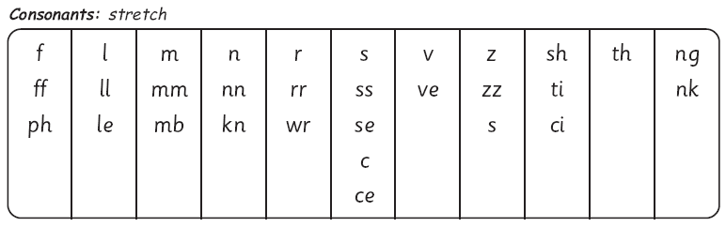
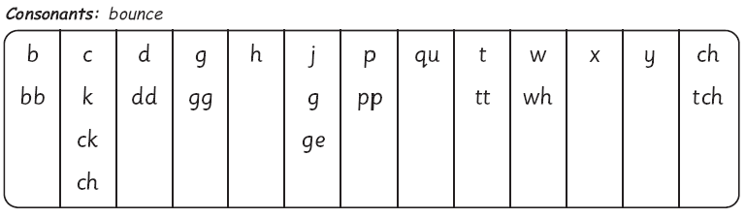
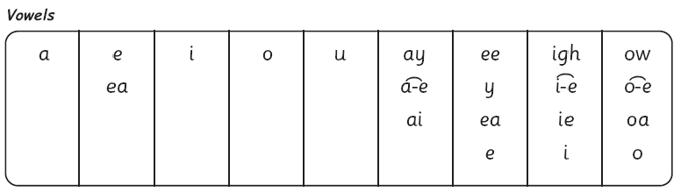
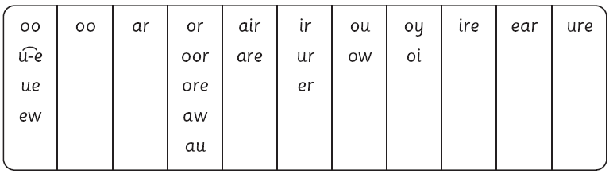
The complex English alphabetic code

Slide 10

Click the video to watch how to say the set 1 sounds correctly

Slide 11












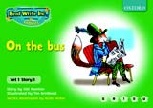

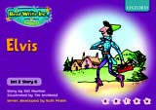



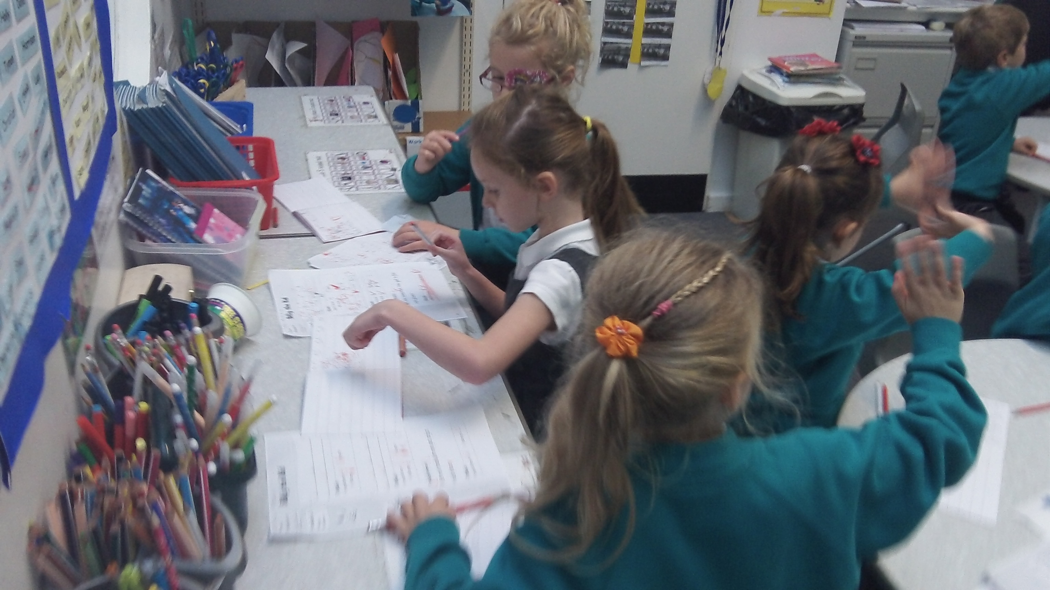
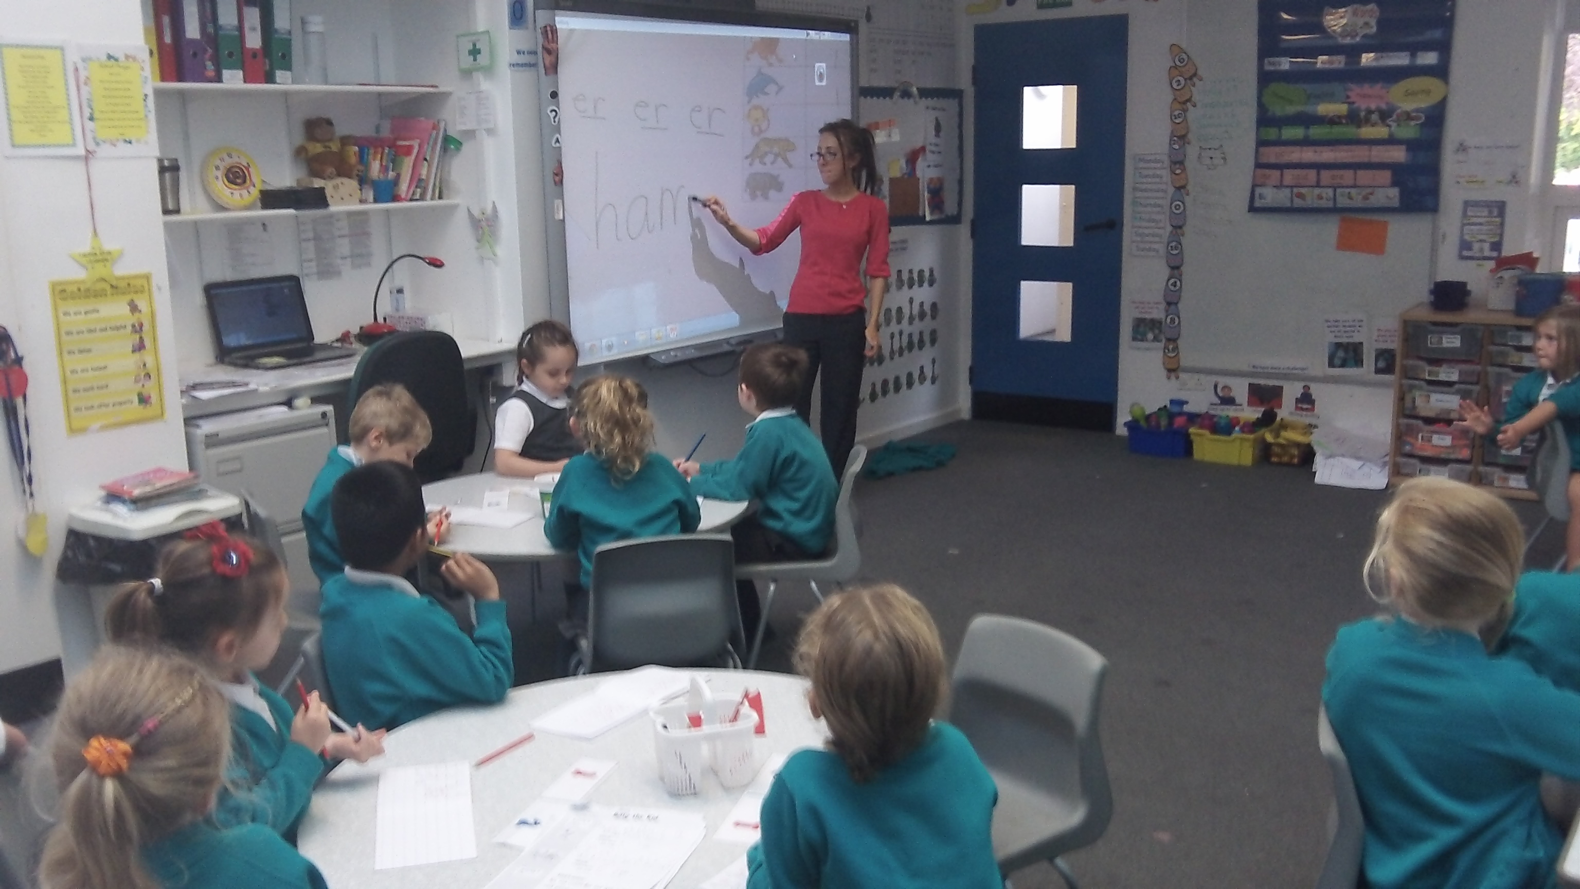
Year 1

Slide 12
The Year 1 Phonics Screening Check
In June your child will take the Phonics Screening Check.
The Phonics Screening Check is a test for children in Year 1 and is taken in a one-to-one setting with a teacher.
Whilst children learn phonics to help them with both word reading and spelling, the Phonics Screening Check only tests their skills at word reading. This is sometimes called decoding.
During the Phonics Screening Check, your child will be asked to read (decode) 40 words. Most of these words are real words but some are pseudo-words (nonsense words). Pseudo-words are included to ensure that your child is using their decoding skills and not just relying on their memory of words they’ve read before.

Slide 13
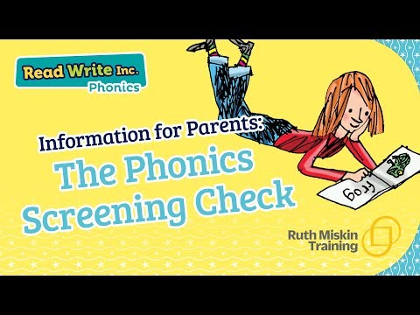
The Phonics Screening Check

Slide 14


Reading at home…

Slide 15
Talking
talking to your child as much as possible and ‘feeding’ them new and different words:
“Let’s eat our lunch now.”
“Let’s munch our lunch now.”
“Let’s scoff our lunch now.”
“Let’s devour our lunch now!”

Slide 16

Why read to your child?
"Children are made readers on the laps of their parents." — Emilie Buchwald

Slide 17
You can watch video tutorials and find out more about Read Write Inc by following these links.
Have a look at these useful links for more information, tips and resources to help you support your child at home:
How to pronounce the sounds correctly click here:
RWI information page for parents (with videos) click here:
Videos showing how each part of a lesson is taught click here
Advice and support for parents click here
Notes:
Listed above are some useful websites.

Slide 18
Contact us!
If there is anything you are unsure of or if you would like further information, please do not hesitate to contact your child's class teacher or Miss King (Reading Leader) via the office email.
We are more than happy to help!
Office email:
office@sma.odbst.org
Notes:
Listed above are some useful websites.

