Slide 1
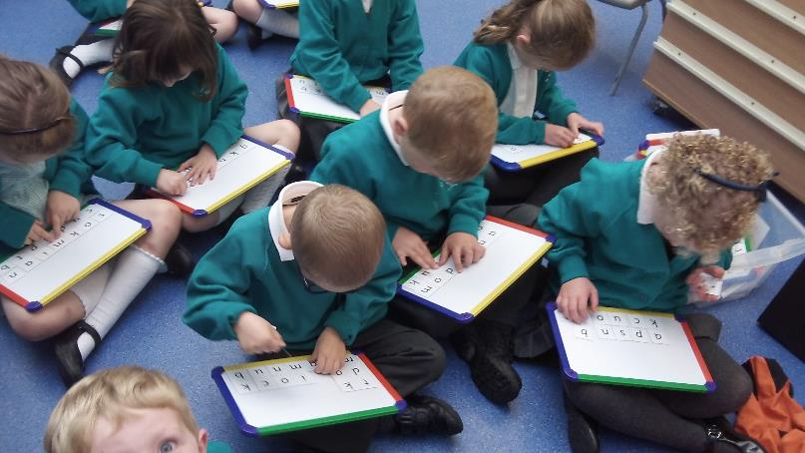

Read, Write Inc. (RWI)
In Reception

Slide 2
Why do we use RWI to teach your child to read and write?
Who is Read Write Inc. (RWI) Phonics for?
The Read Write Inc. Phonics programme is for primary school children learning to read.
It enables your child to become a confident and fluent reader on their first attempt.
Every child who completes Read Write Inc. Phonics learns to read fluently and confidently.
The reading teacher (please see list of reading teachers on the first slide) is guided from the very beginning to help your child to become a confident and fluent reader.

Slide 3
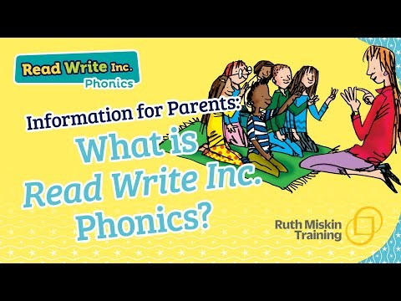
An overview of the RWI programme
*Please note the video states that children bring home the RWI book they are reading in class. At St Mary’s we do not send these books home with the children, (they are only used in class) instead we send home a book from a different reading scheme that is matched by level to the one they are reading in class.

Slide 4
Why we are successful at getting your child to read
The systematic and lively programme is organised by our Reading Leader Miss King.
All of our staff who teach RWI (Teachers and Teaching Assistants) are trained together by the Reading Leader as well as receiving additional training and support from a RWI regional trainer.
Your child will read and write for an hour each day and is grouped according to their reading level.
Your child will not struggle because of work being too difficult nor will they get bored because the work is too easy.
If your child does need extra support to maintain progress, they will work with a reading tutor for 10 minutes in the afternoons to ensure that they do not fall behind their peers.

Slide 5
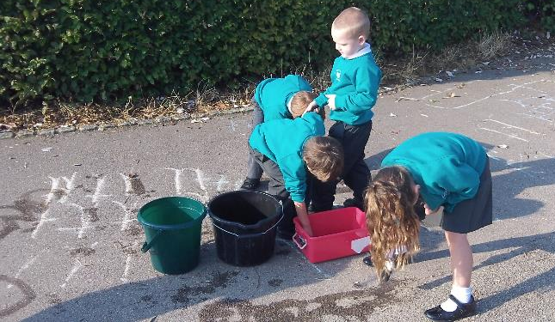
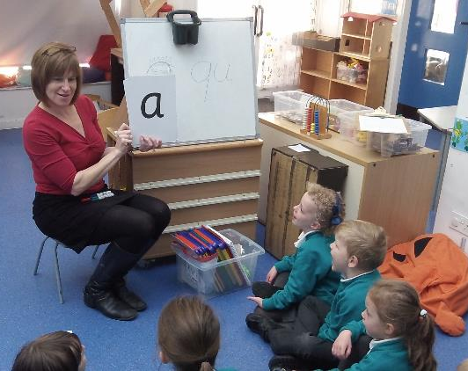
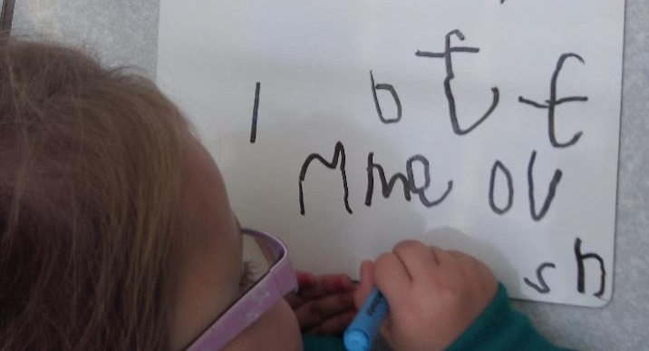
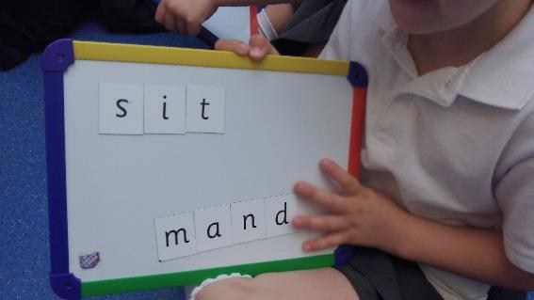
How we teach children to read in Reception using the RWI programme

Slide 6

Click the video to watch how to say the set 1 sounds correctly

Slide 7

Teaching Set 1 sounds
Here is an example lesson showing exactly how we teach the set 1 sounds (a-z including th, sh, ng, nk, qu) in Reception.
In this session we teach the children how to say the sound, how to write the letter, review previously taught letter sounds and also Fred Talk (for reading)

Slide 8
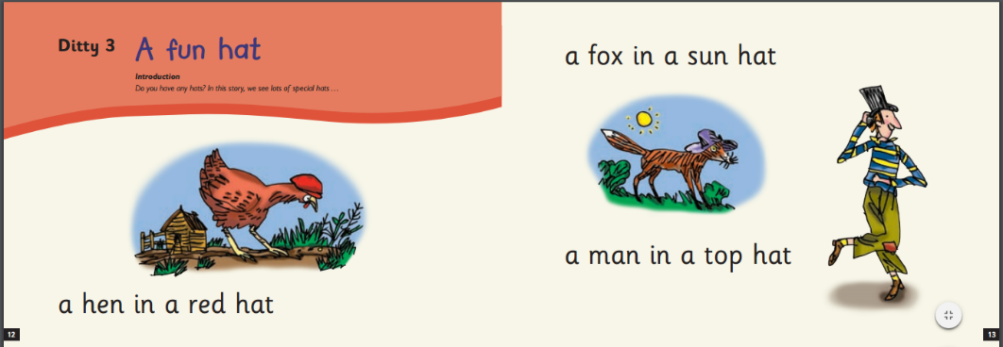
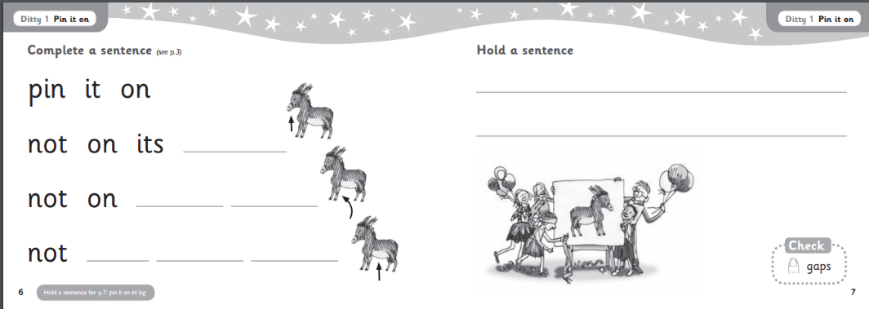
RWI in Reception

Slide 9

How does phonics help us read?
Say “hello” to Fred.
Fred can only talk in sounds...
He says “c_a_t.” Not cat.
We call this Fred Talk.

Slide 10

Spelling

Slide 11

Watch this video to see how to teach your child how to spell using Fred Fingers

Slide 12


Reading at home…

Slide 13
Talking
Talking to your child as much as possible and ‘feeding’ them new and different words:
“Let’s eat our lunch now.”
“Let’s munch our lunch now.”
“Let’s scoff our lunch now.”
“Let’s devour our lunch now!”

Slide 14
You can watch video tutorials and find out more about Read Write Inc by following these links.
Have a look at the parents’ information for tips and resources for supporting your child at home:
How to pronounce the sounds correctly click here:
RWI information page for parents (with videos) click here:
Videos showing how each part of a lesson is taught click here
Advice and support for parents click here
Notes:
Listed above are some useful websites.

Slide 15
Contact us!
If there is anything you are unsure of or if you would like further information, please do not hesitate to contact your childs’ class teacher via the office email or Miss King (Reading Leader) via the office email.
We are more than happy to help!
Office email:
office@st-marysaylesbury.bucksgfl.org.uk
Notes:
Listed above are some useful websites.

