Slide 1


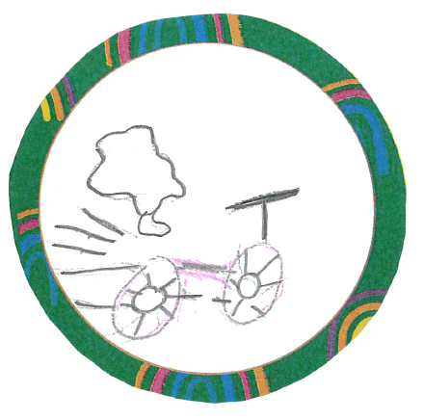
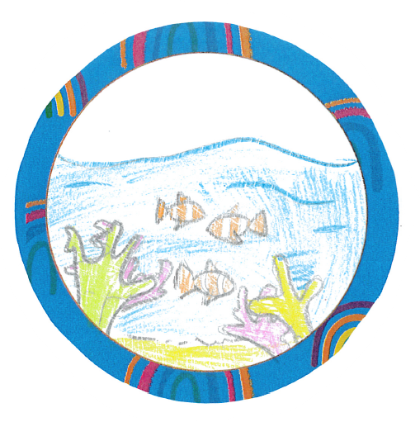
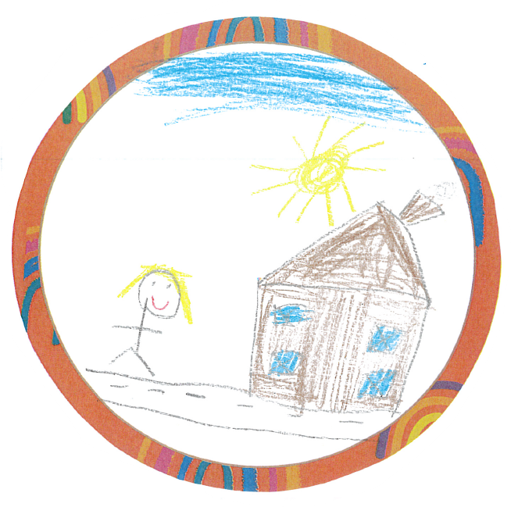
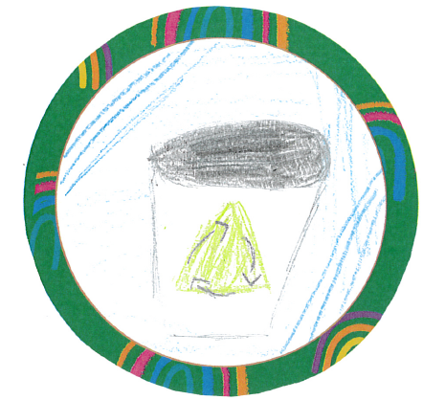

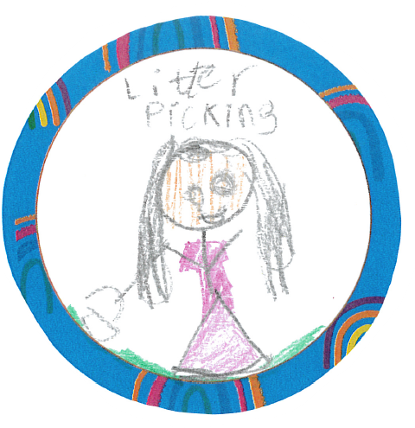
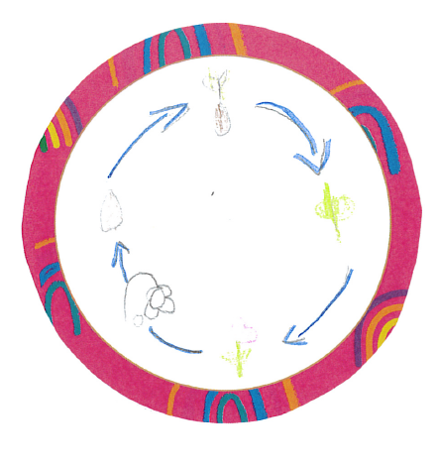
St Mary's Church of England School
Eco Code
Remember to walk, cycle or scoot to school
Remember Marine Life
Transport
Marine
School Grounds
We don’t litter or waste
One chance to Save the World
Waste
Earth
It’s important to respect your school grounds
Appreciate Life
Litter
Biodiversity
Caring for wildlife
Recycling is important everywhere
Opportunity to make a better World
Environment needs protecting

